Slide 1
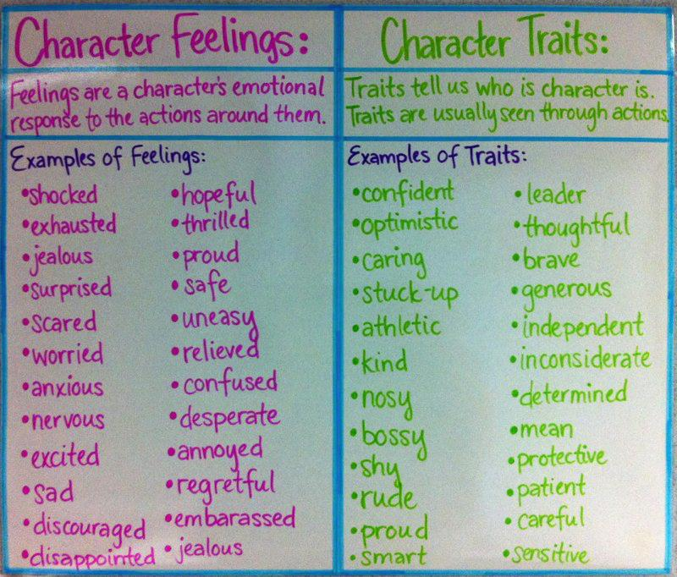
Direct and Indirect Characterization

Slide 2
Traits vs. Emotions
Emotions- Describe a character’s emotional response to things around them (temporary)
Traits- the qualities that make up who a character really is

Slide 3
Characterization
Characterization is what writers use to create and develop characters.
There are two types of characterization
Direct
Indirect

Slide 4
Direct Characterization
The writer directly states or describes the characters’ traits.
Example – “The new boy and quiet girl were at the basketball game together.”

Slide 5
Indirect Characterization
You must make an INFERENCE based on a characters
Speech
Thoughts
Actions
What is an inference?
Educated guess based on clues provided

Slide 6
SPEECH
What does the character say?
How does the character speak?
Example – “Hey, we can have lots of fun at camp this summer! I love being outside!”

Slide 7
THOUGHTS
What is revealed through the character’s thoughts and feelings?
Example – “I wish it would stop raining! I am very tired of sitting inside! There is nothing to do!”

Slide 8
ACTIONS
What does the character do?
How does the character behave?
Example – The girl rode the lawn mower through the house and into the garage.

Slide 9
REMEMBER
The difference between direct characterization and indirect characterization is TELLING vs. SHOWING!!!

Slide 10
Your Turn
Determine if the example is direct/indirect characterization.
If the example is indirect characterization….
*Think about if it was the character’s speech, thoughts, or actions.

Slide 11
PRACTICE
Jim was an honest man. He never cheated anybody in his entire life.

Slide 12
PRACTICE
Jim was an honest man. He never cheated anybody in his entire life.
DIRECT CHARACTERIZATION

Slide 13
PRACTICE
John cared a lot for the well being of others. There was an odd couple living alone near his house. John used to buy weekly groceries for them and even check on them everyday, just to see how they are doing.

Slide 14
PRACTICE
John cared a lot for the well being of others. There was an odd couple living alone near his house. John used to buy weekly groceries for them and even check on them everyday, just to see how they are doing.
DIRECT CHARACTERIZATION

Slide 15
PRACTICE
Julie began fixing supper while the children played. First, she washed the romaine lettuce with grapefruit seed extract. Then she got out the mill to grind the corn. After it was ready, she used honey to replace the sugar in the recipe and put the cornbread in the oven. The dried beans were simmering in the crock pot. She washed and cut up the fresh strawberries they had picked that morning for dessert.

Slide 16
PRACTICE
Julie began fixing supper while the children played. First, she washed the romaine lettuce with grapefruit seed extract. Then she got out the mill to grind the corn. After it was ready, she used honey to replace the sugar in the recipe and put the cornbread in the oven. The dried beans were simmering in the crock pot. She washed and cut up the fresh strawberries they had picked that morning for dessert.
INDIRECT CHARACTERIZATION
ACTIONS – Through her actions, we see a conscientious mother concerned about the nutrition of her family. She cares enough to work harder in preparing meals the way she thinks is best.

Slide 17
PRACTICE
As he sat brooding in his room, Caleb thought of how his baby sister spoiled everything. He thought of how things used to be before she arrived. He wanted to go to Disney World and have fun for his fourth birthday! He got an idea. Buck, their neighbor, feeds the dogs when they go out of town, so Buck could come by and feed the baby when he came to feed the dogs. He loved to play with her, and he could do that. He got up to go tell his mother.

Slide 18
PRACTICE
As he sat brooding in his room, Caleb thought of how his baby sister spoiled everything. He thought of how things used to be before she arrived. He wanted to go to Disney World and have fun for his fourth birthday! He got an idea. Buck, their neighbor, feeds the dogs when they go out of town, so Buck could come by and feed the baby when he came to feed the dogs. He loved to play with her, and he could do that. He got up to go tell his mother.
INDIRECT CHARACTERIZATION
THOUGHTS - Here we see the thoughts of a little boy and his frustrations with his new baby sister and the solution he thought of to solve the problem!

Slide 19
PRACTICE
The husband was fussing at his wife. “That bag of lettuce is half empty! Why don’t you try to get one that had more in it? I can’t believe you didn’t look at the bag more carefully at the grocery store!”

Slide 20
PRACTICE
The husband was fussing at his wife. “That bag of lettuce is half empty! Why don’t you try to get one that had more in it? I can’t believe you didn’t look at the bag more carefully at the grocery store!”
INDIRECT CHARACTERIZATION
Speech – Through his words, the husband is characterized as picky and critical. The author doesn’t have to tell us these characteristics.

Slide 21
PRACTICE
Linda was a strong woman who lived her entire life on her own terms, without compromising and without ever being apologetic for anything.

Slide 22
PRACTICE
Linda was a strong woman who lived her entire life on her own terms, without compromising and without ever being apologetic for anything.
DIRECT CHARACTERIZATION

Slide 23
PRACTICE #8
After visiting my sister Megan, Bobby said, “She really knows how to get a lot of storage into every space, doesn’t she?”
“Yes,” I answered. “Organizing is a fun challenge for her and is what she enjoys. She never stops, but keeps reorganizing in a better way!”

Slide 24
PRACTICE #8
After visiting my sister Megan, Bobby said, “She really knows how to get a lot of storage into every space, doesn’t she?”
“Yes,” I answered. “Organizing is a fun challenge for her and is what she enjoys. She never stops, but keeps reorganizing in a better way!”
INDIRECT CHARACTERIZATION
AFFECT ON OTHERS TOWARD THE CHARACTER – From this conversation between Frances and Jean’s sister, the reader gets a picture of Jean’s organizational skills.

Slide 25
Let’s Review…
characterization review

Slide 26
Video Clips
Watch the following video clips and determine whether it is showing direct or indirect characterization! Explain your reasoning for your selection.

Slide 27
Determining Direct & Indirect Characterization Through Video Clips
Video Clip | DIRECT/INDIRECT Characterization | How do you know?
Video Clip #1 | DIRECT / INDIRECT
Video Clip #2 | DIRECT / INDIRECT
Video Clip #3 | DIRECT / INDIRECT
Video Clip #4 | DIRECT/INDIRECT
Video Clip #5 | DIRECT/INDIRECT
Video Clip #6 | DIRECT/INDIRECT

Slide 28
Video Clip #1
Mean Girls
Clip 1
Notes:
****http://www.youtube.com/watch?v=ImA7CILOTTw

Slide 29
Video Clip #2
Hunger Games
clip

Slide 30
Video Clip #3
Twilight
video clip

Slide 31
Video Clip 4
Zootopia
-Clip 4

Slide 32
Video Clip 5
Harry Potter and The Sorcerer’s Stone
-Clip 5

Slide 33
Video Clip 6
The LEGO Batman Movie
-Clip 6

Slide 34
Check Your Answers
VIDEO CLIP | DIRECT / INDIRECT CHARACTERIZATION
Mean Girls | DIRECT CHARACTERIZATION
Hunger Games | INDIRECT CHARACTERIZATION
Twilight | DIRECT CHARACTERIZATION
Zootopia | INDIRECT CHARACTERIZATION
Harry Potter and the Sorcer’s Stone | INDIRECT CHARACTERIZATION
The LEGO Batman Movie | DIRECT CHARACTERIZATION

Slide 35
PERFORMANCE TASK!
Choose a trait from the basket.
Create a short skit with your group (assigned by Mrs. Humbyrd) to indirectly show these traits to your classmates. You have approximately 5-7 minutes to plan.
Make sure you demonstrate this trait through a characters thoughts, speech, or actions.
Your classmates will then infer what traits you are performing.

